Slide 1
Selected Shell Features
Lesson #3

Slide 2
Korn Shell Variables

Slide 3
Parent Process-id
# ps
PID TTY TIME CMD
18750 pts/1 0:00 /bin/ksh
27916 pts/1 0:00 ps
# echo $$
18750
# /bin/ksh

Slide 4

Parent Process-id
# ps
PID TTY TIME CMD
13390 pts/1 0:00 ps
18750 pts/1 0:00 /bin/ksh
27918 pts/1 0:00 /bin/ksh
# echo $$
27918
# echo $PPID
18750
# exit

Slide 5

Present Working Directory
# pwd
/usr/scripts
# echo $PWD
/usr/scripts
# cd /tmp
# pwd
/tmp
# echo $PWD
/tmp
#

Slide 6
Previous Working Directory
# echo $PWD
/tmp
# echo $OLDPWD
/usr/scripts
# cd $OLDPWD
# pwd
/usr/scripts
# echo $PWD
/usr/scripts
# echo $OLDPWD
/tmp
#

Slide 7
Random Number Generator
# echo $RANDOM
21350
# echo $RANDOM
29195
# r
echo $RANDOM
15471
# r
echo $RANDOM
2027
#

Slide 8
Shell Age In Seconds
Parent Shell
# echo $SECONDS
2335
# /bin/ksh
# echo $SECONDS
3
# echo $SECONDS
33
# exit
# echo $SECONDS
2385
#
Child Shell
Parent Shell

Slide 9
Shell Age In Seconds
Shellscript ‘seconds_a’
tput clear
echo The program name is $0
for i in 1 2 3 4 5
do
echo $SECONDS
sleep 1
done
sleep 5
tput clear

Slide 10
Shell Age In Seconds
( Parent )
# ps
PID TTY TIME CMD
13522 pts/1 0:00 /bin/ksh
18844 pts/1 0:00 ps
# echo $SECONDS
760
# seconds_a
The program name is seconds_a
764
765
766
767
768
# echo $SECONDS
779
#
Parent Shell
Child Shell
Parent Shell

Slide 11

Shell Age In Seconds
Shellscript ‘seconds_b’
#!/bin/ksh
tput clear
echo The program name is $0
for i in 1 2 3 4 5
do
echo $SECONDS
sleep 1
done
sleep 5
tput clear

Slide 12
Shell Age In Seconds
( Child )
# echo $SECONDS
1137
# seconds_b
The program name is seconds_b
0
1
2
3
4
# echo $SECONDS
1167
#
Parent Shell
Child Shell
Parent Shell

Slide 13
Script Line being Executed
Shellscript ‘script_line’
echo Executing Line Number $LINENO
echo The program name is $0
echo Executing Line Number $LINENO
for i in 1 2 3 4 5
do
echo Executing Line Number $LINENO
echo $SECONDS
sleep 1
done
echo Executing Line Number $LINENO
sleep 5

Slide 14
Script Line being Executed
# script_line
Executing Line Number 1
The program name is script_line
Executing Line Number 3
Executing Line Number 6
1734
Executing Line Number 6
1735
Executing Line Number 6
1736
Executing Line Number 6
1737
Executing Line Number 6
1738
Executing Line Number 10

Slide 15
Shell Timeout
# echo $TMOUT
0
# TMOUT=10
# echo $TMOUT
10
#
Shell will time out in 60 seconds.

Slide 16
Terminal Capabilities

Slide 17
Online Documentation
# man terminfo | pg
-------------------------------------------------------------------------------
Files Reference
-------------------------------------------------------------------------------
terminfo Directory
Purpose
Contains compiled terminfo source files.

Slide 18
Online Documentation
Description
Terminfo is a compiled database describing the capabilities of terminals.
Terminals are described in the terminfo source files via entries. Each entry
contains information about the capabilities for a particular terminal or set of
common terminals. Capabilities include the operations that can be performed, thepadding requirements, cursor positioning, command sequences, and initialization
sequences.
The compiled terminfo database is used by applications such as curses and vi
that must have knowledge of the terminal but do not want to be
: /String Capabilities/

Slide 19
Online Documentation
String Capabilities
You define string-valued capabilities, such as the el capability (clear to end
of line) with a 2-character code, an = (equal sign), and a string ending with a
, (comma). A delay in milliseconds can appear anywhere in a string capability.
: +3

Slide 20
Online Documentation
String Capabilities
Variable Cap Name I.Code Description
appl_defined_str apstr za Application-defined terminal string.
asc_chars acsc ac Alternate character set mapping of glyph to characters.
back_tab cbt bt Back tab.
bell bel bl Produces an audible signal (bell).
: <cr>

Slide 21
Online Documentation
clear_all_tabs tbc ct Clears all tab stops.
clear_margins mgc MC Clear left and right soft margins.
clear_screen clear cl Clears screen and puts cursor in home position. (*)
clr_bol el1 cb Clear to beginning of line, inclusive.
: <cr> or quit

Slide 22

Background Color
# tput colb1
# echo $RANDOM
2043
# tput colb2
# echo $RANDOM
15375
# tput colb3
# echo $RANDOM
# tput colb4
# echo $RANDOM
14238
#
RED
GREEN
YELLOW
BLUE

Slide 23
Background Color
# tput colb5
# echo $RANDOM
2043
# tput colb6
# echo $RANDOM
15375
# tput colb7
# echo $RANDOM
# tput colb0
# echo $RANDOM
14238
#
PURPLE
CYAN (light green)
White
Black

Slide 24
Background Color
# tput colb3
# tput clear
#
Paints Entire Screen

Slide 25
Foreground Color
# tput colf1
# echo $RANDOM
2043
# tput colf2
# echo $RANDOM
15375
# tput colf3
# echo $RANDOM
# tput colf4
# echo $RANDOM
14238
#
RED
GREEN
YELLOW
BLUE

Slide 26
Foreground Color
# tput colf5
# echo $RANDOM
2043
# tput colf6
# echo $RANDOM
15375
# tput colf7
# echo $RANDOM
# tput colf0
# echo $RANDOM
14238
#
PURPLE
CYAN (light green)
White
Black

Slide 27
Modifying Window Colors
# tput colb1
# tput colf1
# tput colf0
# tput colb0
# tput colf7
#
BG=black FG=white
BG=red FG=white
BG=red FG=white
BG=red FG=red
BG=red FG=black
BG=black FG=black
BG=black FG=white

Slide 28
Reverse Video
# tput colb0
# tput colf7
# tput rev
# echo $RANDOM
11223
# tput colb1
# echo $RANDOM
16566
# tput rmso
# echo $RANDOM
2971
#
BG=black FG=white
BG=white FG=black
BG=white FG=RED
BG=RED FG=white

Slide 29
Underlining
# tput colb0
# tput colf7
# tput smul
# echo $RANDOM
30847
# tput rmul
# echo $RANDOM
31745
#

Slide 30
QUOTES & BACKTIC

Slide 31
Quotes & Backtic
Single Quotes – Suppress Variable Substitution.
# echo Current Directory is $PWD
Current Directory is /usr/scripts
# echo 'Current Directory is $PWD'
Current Directory is $PWD
#

Slide 32
Quotes & Backtic
Double Quotes – Performs Variable Substitution.
# echo Current Directory is $PWD
Current Directory is /usr/scripts
# echo “Current Directory is $PWD”
Current Directory is /usr/scripts
#

Slide 33
Quotes & Backtic
Backslash ( \ ) – Suppress Variable Substitution.
# echo Current Directory is $PWD
Current Directory is /usr/scripts
# echo “Current Directory is $PWD”
Current Directory is \$PWD
#

Slide 34
Quotes & Backtic
Backtic ( ` ) – Execution output assigned to variables
# hostname
mcsrv1
# echo `hostname`
mcsrv1
# echo " `hostname` "
mcsrv1

Slide 35
Quotes & Backtic
Backtic ( ` ) – Execution output assigned to variables
# echo ' `hostname` '
`hostname`
# var="My host is `hostname`"
# echo $var
My host is mcsrv1
#

Slide 36
Menu Creation
( Korn Shell only )

Slide 37
Creating a Basic Menu
Create and execute the following shellscript – ‘ basic_menu ‘
tput clear
PS3=">>>>: "
select option in one quit
do
case $option in
one) print "one";;
quit)break;;
*) print "invalid";;
esac
done

Slide 38
Creating a Basic Menu
Create and execute the following shellscript – ‘ basic_menu ‘
tput clear
PS3=">>>>: "
select option in one quit
do
case $option in
one) print "one";;
quit)break;;
*) print "invalid";;
esac
done

Slide 39
Creating a Basic Menu
Create and execute the following shellscript – ‘ basic_menu ‘
tput clear
PS3=">>>>: "
select option in one quit
do
case $option in
one) print "one";;
quit)break;;
*) print "invalid";;
esac
done

Slide 40
Creating a Basic Menu
Create and execute the following shellscript – ‘ basic_menu ‘
tput clear
PS3=">>>>: "
select option in one quit
do
case $option in
one) print "one";;
quit)break;;
*) print "invalid";;
esac
done

Slide 41
Creating a Basic Menu
Create and execute the following shellscript – ‘ basic_menu ‘
tput clear
PS3=">>>>: "
select option in one quit
do
case $option in
one) print "one";;
quit)break;;
*) print "invalid";;
esac
done

Slide 42
Creating a Basic Menu
Create and execute the following shellscript – ‘ basic_menu ‘
tput clear
PS3=">>>>: "
select option in one quit
do
case $option in
one) print "one";;
quit)break;;
*) print "invalid";;
esac
done

Slide 43
Basic Menu
# basic_menu
1) one
2) quit
>>>>: 1
one
>>>>: 2
#
Problem: Menu Not Redisplayed

Slide 44
Menu Regeneration
Modify and execute shellscript – ‘ basic_menu ‘
tput clear
PS3=">>>>: "
select option in one quit
do
case $option in
one) print "one";
sleep 3;
exec basic_menu;;
quit) break;;
*) print "invalid";
exec basic_menu;;
esac
done

Slide 45

Menu Regeneration
# basic_menu
1) one
2) quit
>>>>: 1
one
1) one
2) quit
>>>>: 2
#

Slide 46
Descriptive Menu Items
Modify and execute shellscript – ‘ basic_menu ‘
tput clear
PS3=">>>>: "
select option in one “Process Status” quit
do
case $option in
one) print "one";
sleep 3;
exec basic_menu;;
“Process Status”) ps;
sleep 3;
exec basic_menu;;

Slide 47
Descriptive Menu Items
Modify and execute shellscript – ‘ basic_menu ‘
quit) break;;
*) print "invalid";
exec basic_menu;;
esac
done

Slide 48
Descriptive Menu Items
# basic_menu
1) one
2) Process Status
3) quit
>>>>: 2
PID TTY TIME CMD
15370 pts/1 0:00 ps
27054 pts/1 0:00 /bin/ksh
27230 pts/1 0:00 /bin/ksh
One
Process Status
3) quit
>>>>: 3
#

Slide 49
Creating Sub-Menu Control
Modify and execute shellscript – ‘ basic_menu ‘
tput clear
PS3=">>>>: "
select option in one “Process Status” “Sub_Menu” quit
do
case $option in
one) print "one";
sleep 3;
exec basic_menu;;
“Process Status”) ps;
sleep 3;
exec basic_menu;;

Slide 50
Creating Sub-Menu Control
Execute the call to the sub-menu
“Sub_Menu”) exec sub_menu;;
quit) break;;
*) print "invalid";
exec basic_menu;;
esac
done

Slide 51
Creating Sub-Menu
Create shellscript – ‘ sub_menu ‘
tput clear
PS3=">>>>: "
select option in “Process Status” quit
do
case $option in
“Process Status”) ps;
sleep 3;
exec sub_menu;;
quit) exec basic_menu;;
*) print "invalid";
exec sub_menu;;
esac
done

Slide 52
Main Menu
# basic_menu
1) one
2) Process Status
3) Sub_Menu
4) quit
>>>>: 1
one

Slide 53
Main Menu
1) one
2) Process Status
3) Sub_Menu
4) quit
>>>>: 2
PID TTY TIME CMD
15370 pts/1 0:00 ps
27054 pts/1 0:00 /bin/ksh
27230 pts/1 0:00 /bin/ksh

Slide 54
Sub-Menu
1) one
2) Process Status
3) Sub_Menu
4) quit
>>>>:3
1) Process Status
2) quit
>>>>:

Slide 55
Sub-Menu
1) Process Status
2) quit
>>>>: 1
PID TTY TIME CMD
15970 pts/1 0:00 ps
27054 pts/1 0:00 /bin/ksh
pts/1 0:00 /bin/ksh

Slide 56
Sub-Menu
1) Process Status
2) quit
>>>>: 2
1) one
2) Process Status
3) Sub_Menu
4) quit
>>>>: 4
#

Slide 57
Korn Shell Menu Control
Lab #2 Assigned

Slide 58
Lab 2 – General Instructions
Menu Program which will eventually launch all course assignments
Headings documentation requirements:
  Name
  Course
  Lab
  Date

Slide 59
Lab 2 – General Instructions
Document command usage for first instance only
Shellscripts MUST be completed ontime
Assigned Due Date:
  Run shellscripts for instructor
  Turn-in hardcopy of all shellscripts

Slide 60
Lab 2
Change Background and Foreground colors (Student Choices)
Display a Menu with two selections:
  Launch Lab 1C
  Exit
Menu MUST be displayed half way down the screen along the left edge after clearing the screen
Menu Items MUST be Descriptive

Slide 61
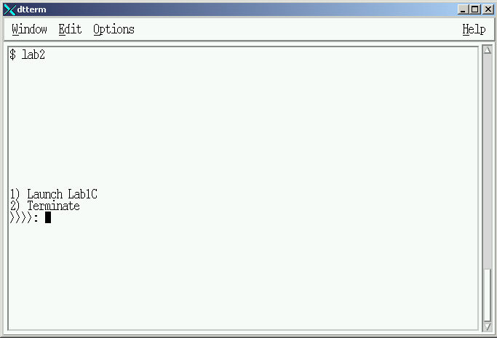

Slide 62
Lab 2
Menu Item – “Launching Lab1C”
  Background=yellow and Foreground=blue
  Execute Lab1C
  Regenerate the Menu after “Lab1C” execution

Slide 63
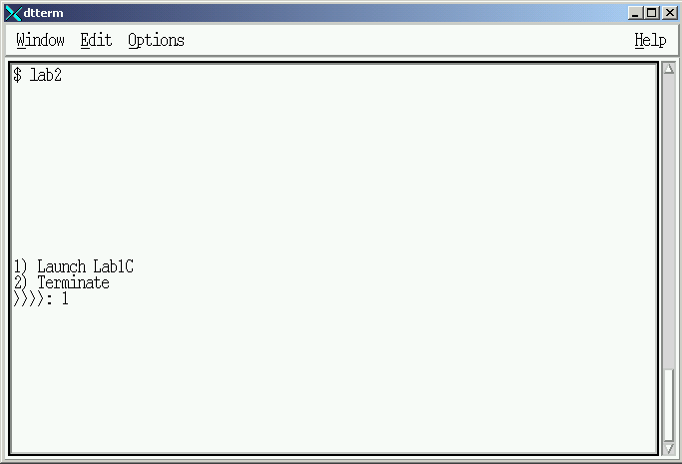

Slide 64
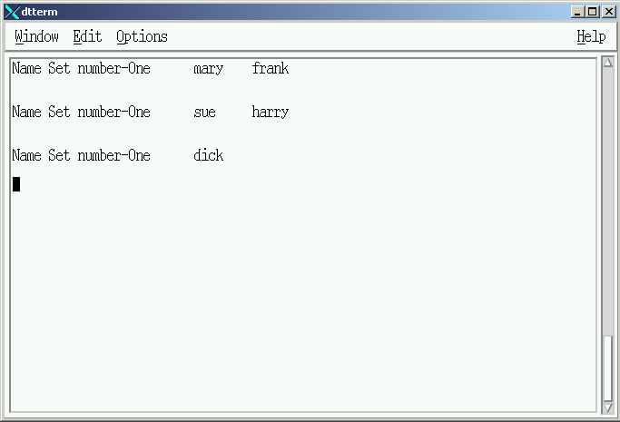

Slide 65
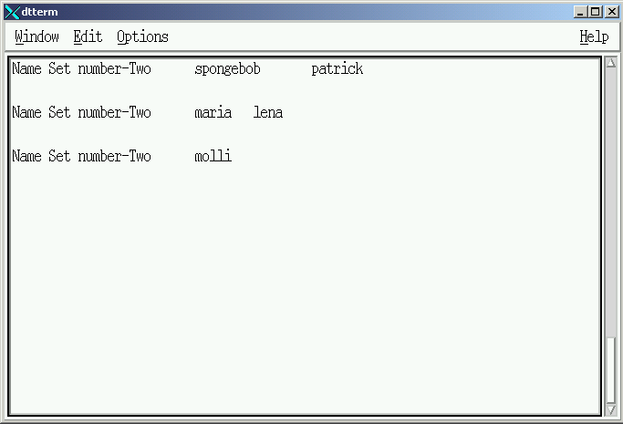

Slide 66
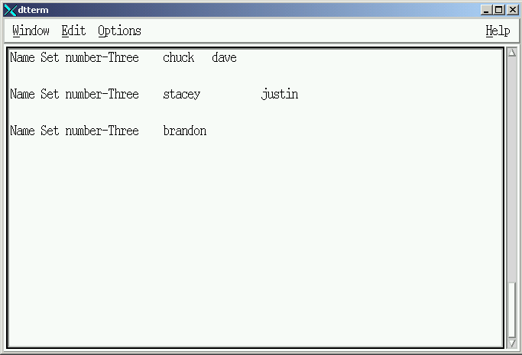

Slide 67
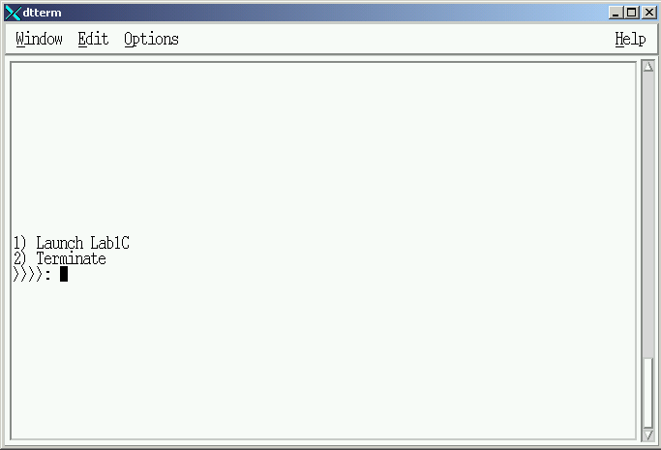

Slide 68
Lab 2
Default Menu Item
  Clear screen
  Display ERROR Message in the middle of the screen for 5 seconds
  Clear screen
  Regenerate the Menu

Slide 69


Slide 70
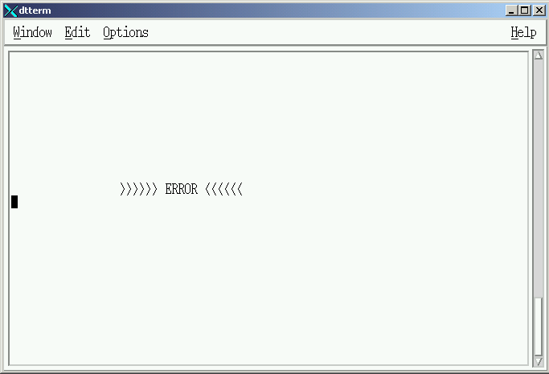

Slide 72
Lab 2
Menu Item – “Exit”
  Clear screen
  Background=black and Foreground=white
  Return to UNIX prompt

Slide 73


Slide 74
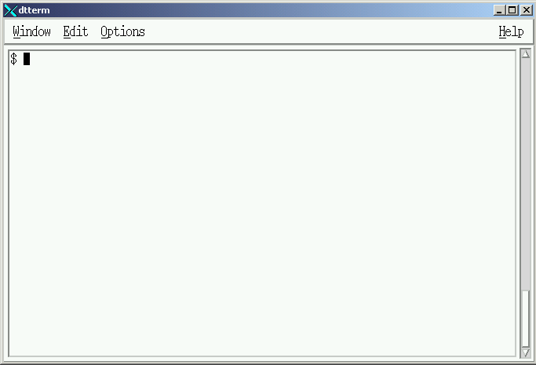

Slide 75
Selected Shell Features
Lesson Completed

